Slide 1


Demand Factor Analysis
Electric Power Load Analysis (EPLA)
Revision of 8 June 2026
Dr. Norbert Doerry
http://doerry.org/norbert/MarineElectricalPowerSystems/index.htm
© 2026 by Norbert Doerry
This work is licensed via: CC BY 4.0 (https://creativecommons.org/)

Slide 2
Essential Questions
When should Demand Factor analysis be performed? | Understand
What are the alternatives to Demand Factor analysis? | Understand
How is Demand Factor analysis performed? | Apply
What are the limitations of Demand Factor Analysis? | Understand

Slide 3
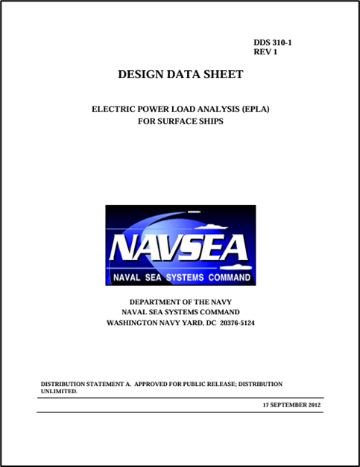
Introduction – Demand Factor Analysis
Used to determine the load current for
  Cables feeding load centers (and power panels)
  Circuit breakers protecting the cables
  Load center (power panel) bus rating
Legacy Method
  Zonal load factor method or stochastic method preferred
Process defined in DPC 310-1

Slide 4
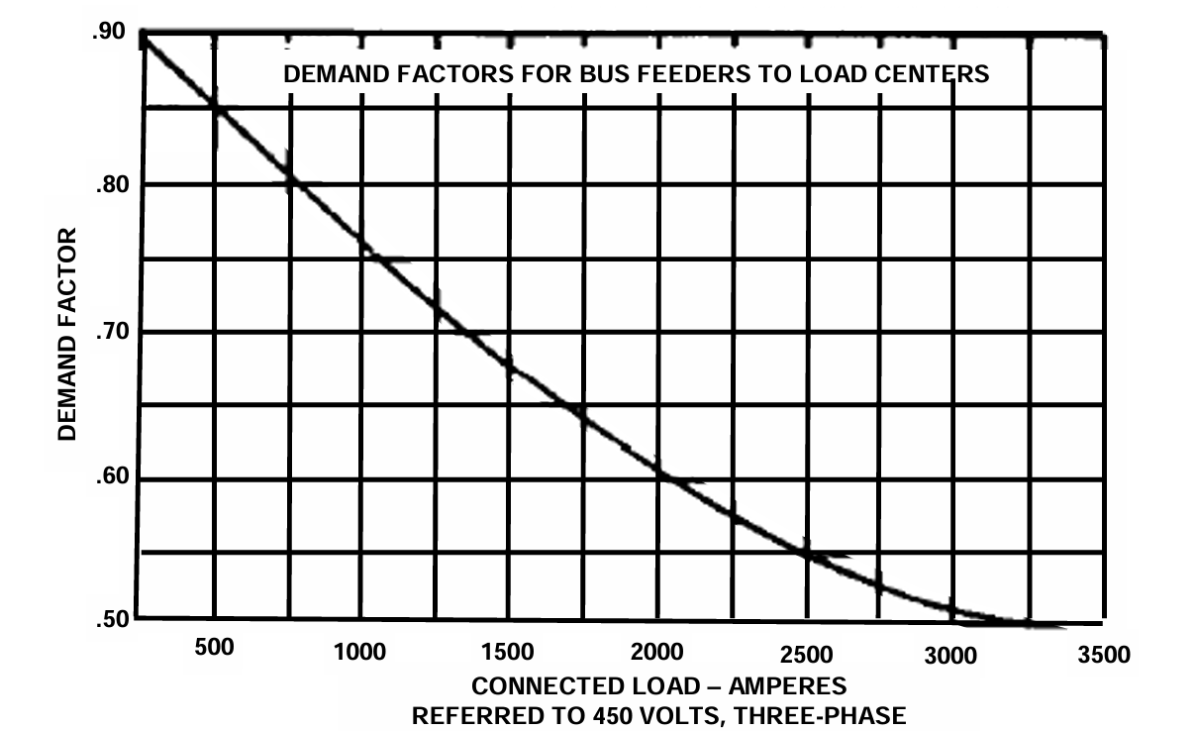
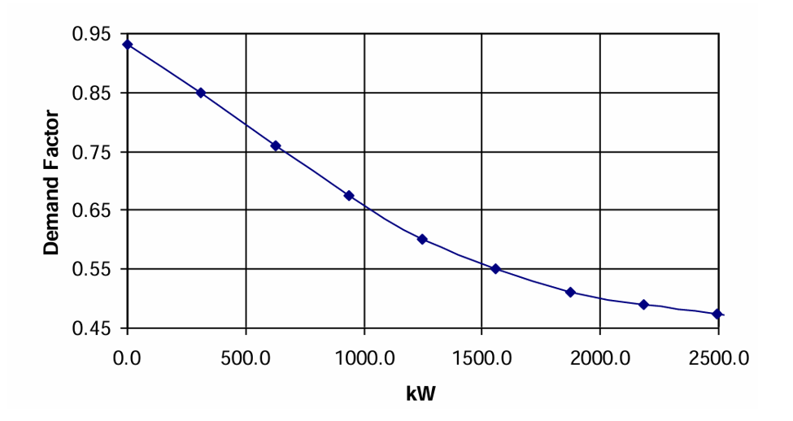
Procedure
“The analysis consists of calculating the connected load for each bus feeder by summing the connected load of all the loads attached to the bus feeder.
Margin and service life allowances are applied to this sum to produce the bus feeder connected load.
The bus feeder and the circuit breaker protecting the bus feeder shall have the capability to service a total load calculated by multiplying the bus feeder connected load expressed in amps with the demand factor from (Figure 1) for 450 volt AC systems or by multiplying the bus feeder connected load expressed in kW with the demand factor from (Figure 2) for other voltages or DC systems.”
from DPC 310-1
Figure 1: Demand Factor Curve (from MS 18299 via DPC 310-1)
Figure 2: Demand Factor Curve based on connected load
(from DPC 310-1)

Slide 5
Discussion
Demand factor method is attractive for its simplicity
  Only need information in the load list
Down side is that it is purely empirical
  May not provide a good estimate if the loads behave in aggregate differently than loads normally encountered in shipboard systems
Other methods with better traceability to data are preferred

